Slide 1
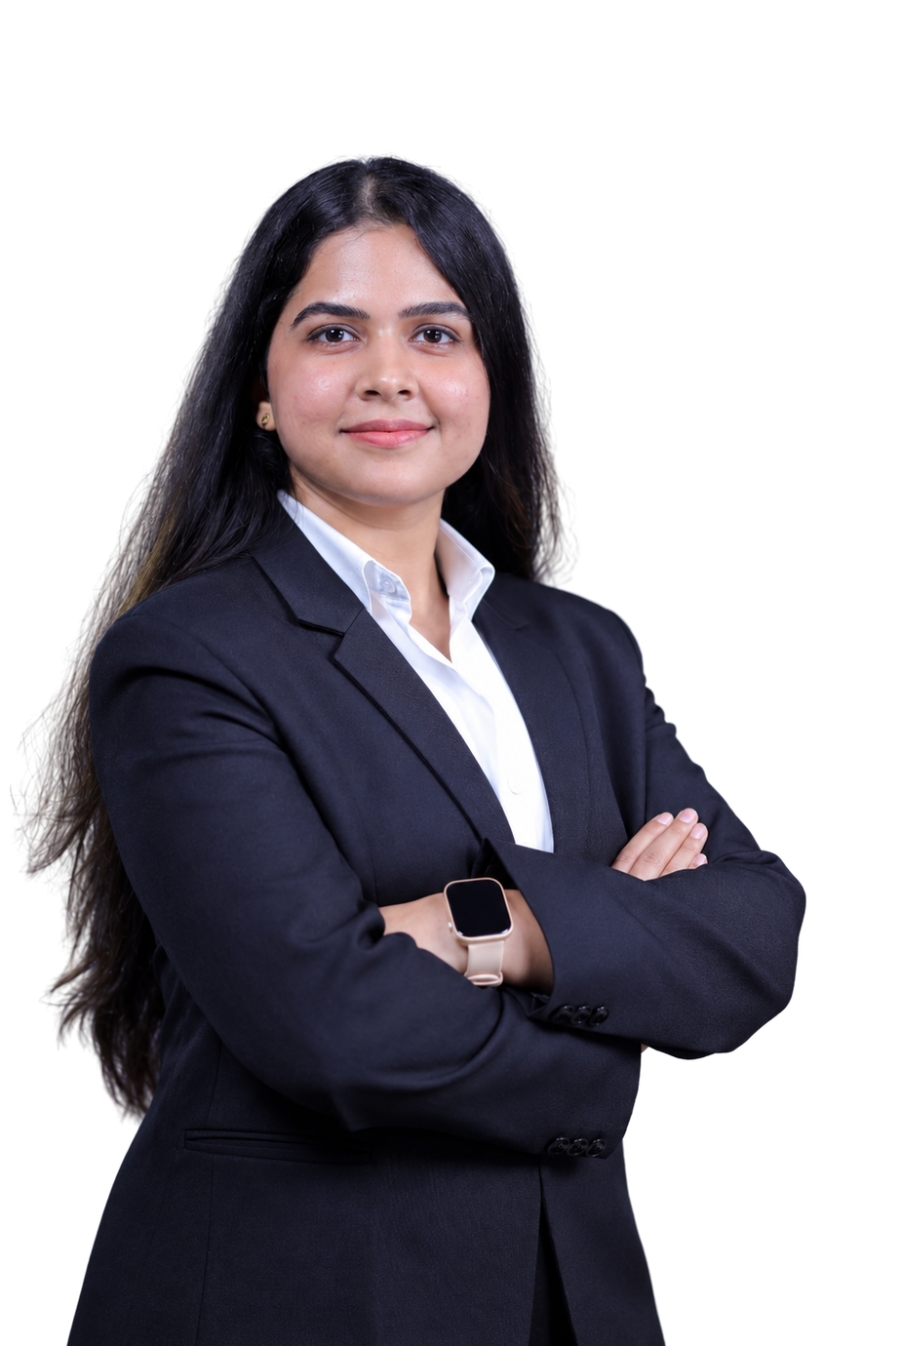

PGDM
FIIB
E-PORTFOLIO 2026
TANYA SINGH
CHAUHAN
Learning and Unlearning. Creating Impact

Slide 2

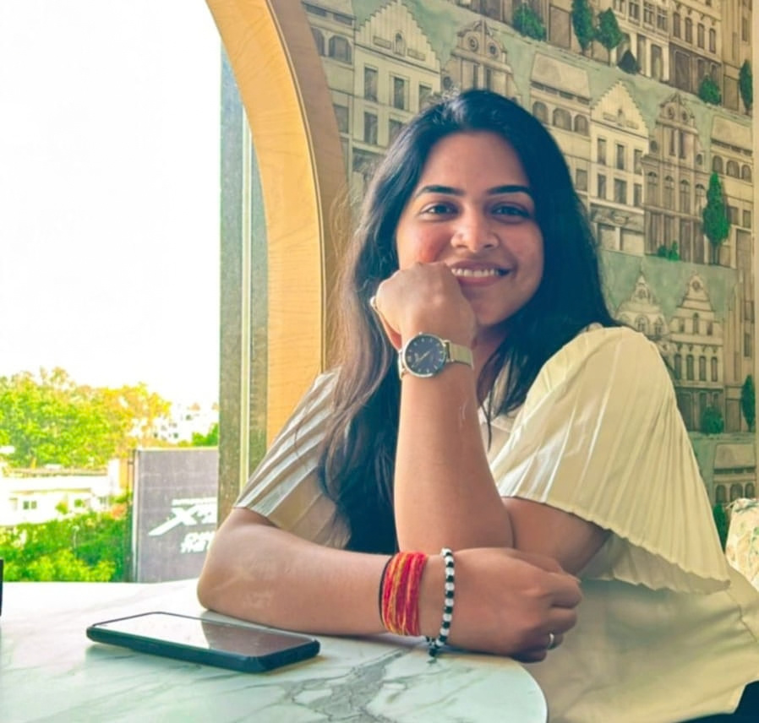


My Journey So Far
2022
B.COM
2022–23
CAT + OMETS PREPARATION
2023–26
FAMILY BUSINESS
+ UPSKILLING
2026–Present
YOUR PHOTO
HERE
PGDM @ FIIB
After completing my B.Com in 2022, I spent the next phase preparing for CAT and OMETS while exploring my path towards management education. I then took on an active role in my family’s reading-room business, gaining hands-on exposure to operations, people and decision-making, while simultaneously upskilling through Excel, Power BI, Business Analysis and other certifications. Today, my PGDM at FIIB is allowing me to build on that practical foundation and explore how I can contribute at the intersection of people, business and problem-solving.
PEOPLE × BUSINESS × PROBLEM-SOLVING

Slide 3

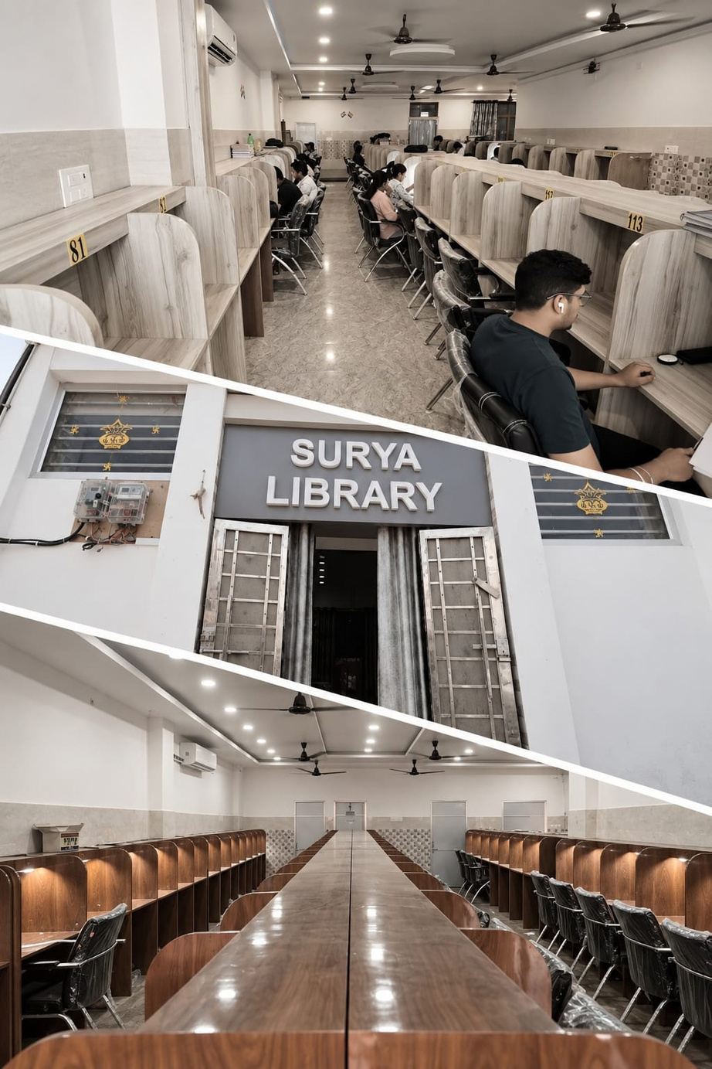


EXPERIENCE
Family Business Experience
Surya Library
Reading Room | Kanpur
What I handled
  Managed day-to-day operations of a 180-seat reading facility
  Coordinated staff and customer requirements
  Handled operational decisions and issue resolution
  Managed electricity/utilities and facility-related expenses
  Interacted directly with customers and understood their expectations
  Worked with limited manpower to keep daily operations running smoothly

Slide 4






BUSINESS ANALYSIS SIMULATION
My project
Requiflex Wireframes
Procurement Process Automation Project
THE PROBLEM
MY APPROACH
Fragmented, manual procurement processes leading to approval delays, errors and limited visibility.
Analysed the BRD & mapped stakeholder workflows
Converted requirements → user stories → acceptance criteria
Translated requirements into a visual system concept
WHAT I WORKED ON
WHAT I LEARNED
• 17 user stories + Given-When-Then acceptance criteria
• How to translate business needs into clear, testable system requirements
• Requiflex wireframes designed from scratch
• How business analysis connects process, technology & user experience
• Final presentation of the proposed solution

Slide 5
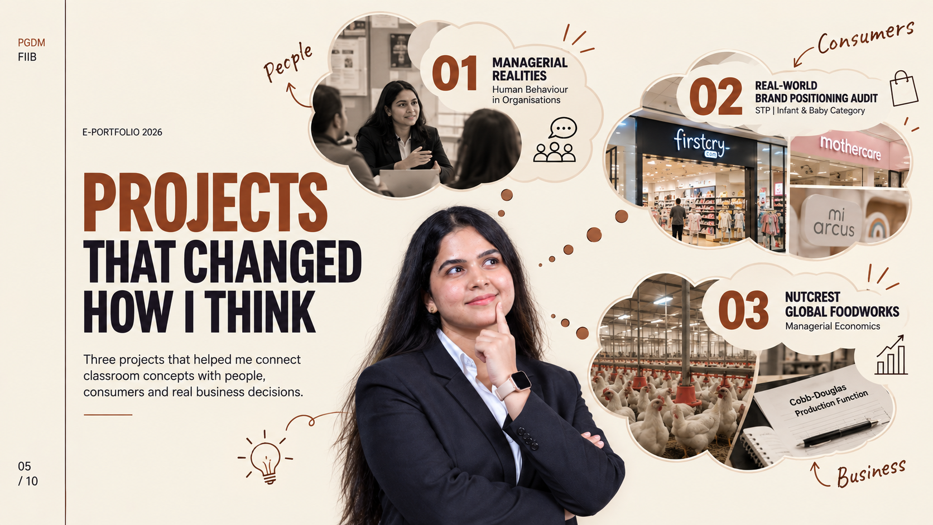

Slide 6


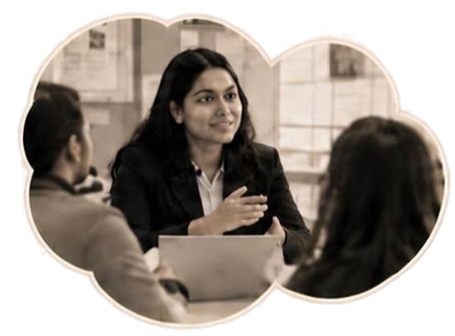






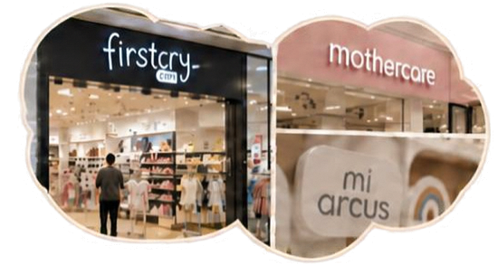






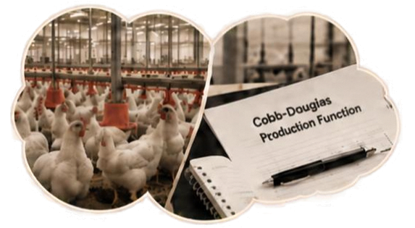





01
MANAGERIAL REALITIES
Worked on:
Conducted 8 industry interviews and compared managerial perspectives on teamwork, motivation, conflict and managerial skills with QB concepts.
Human Behaviour in Organisations
Learned:
Theory provides a framework, practice requires adapting it to people and context.
My project
02
REAL-WORLD
BRAND POSITIONING AUDIT
Worked on:
Visited Mothercare, Mi Arcs & FirstDry at Ambience Mall, analysing store environment, pricing, assortment, customers and communication to connect field observations with brand positioning.
STP | Infant & Baby Category
Marketing–In–Practice
Learned:
My project
Positioning is experienced through what the consumer sees, feels and encounters.
03
NUTCREST
GLOBAL FOODWORKS
Worked on:
Studied a commercial poultry farm through field observation and owner interaction, analysing labour, capital, technology and production using the Cobb Douglas framework.
Managerial Economics
Learned:
My project
Economic concepts became practical when applied to resource allocation and production decisions.

Slide 7











SKILLS I'VE BUILT
A mix of business understanding, analytical thinking and people skills
BUSINESS & ANALYTICS
PEOPLE & MANAGEMENT
Excel • Power BI • Business Analysis • Process Mapping
Stakeholder Interaction • Team Coordination • Conflict Handling • Decision-Making
MARKETING & CONSUMER
COMMUNICATION
STP • Consumer Insights • Brand Positioning • Journey Mapping
Presentations • Research • Interviewing • Report Writing
Built through:
Family Business • Certifications • Business Analysis Simulation • Academic Projects • Fieldwork

Slide 8















Why Me | Where I'm Headed
Resilience
Ownership
People Understanding
Analytical Curiosity
Adapted through setbacks, change and new challenges while continuing to move forward.
Take responsibility and follow through, shaped by my family business experience.
Interested in how
people think, communicate and work within organisations.
Enjoy breaking down problems and connecting concepts to real business situations.
Where I'm headed
Building a career in HR and people-focused business roles, combining people understanding with business thinking.
What I seek from CMP:
Industry exposure • Mentorship • Practical learning • Personal growth

Slide 9





LET'S CONNECT.
Tanya Singh Chauhan
+91 98994 4300
28-tanya.chauhan@fiib.edu.in
LinkedIn
Learning. People. Business. And everything in between.

